Slide 1
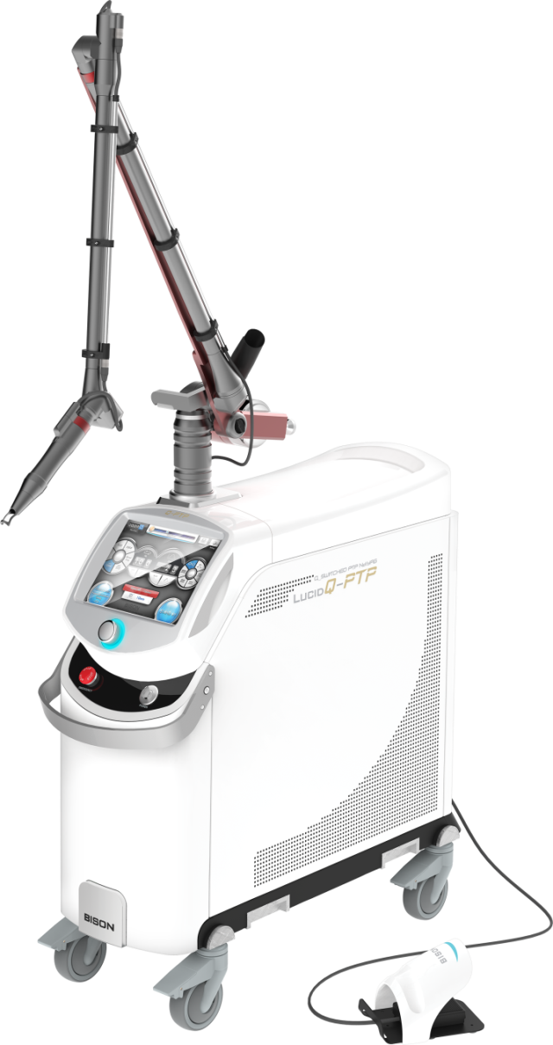
The Clinical Advantages of
Q-Switched Nd:YAG Laser in
Pigmentation and Laser toning
www.bisonmedical.com

Slide 2
Overview
Lucid Nd:YAG
Benefits of Q switched Nd-YAG laser
Various procedures
Conclusion

Slide 3
I. Lucid Nd:YAG
1. What is Q switched laser?
2. Absorption Spectrum of Melanin and Hemoglobin
3. Depth of Penetration by Wavelength
4. User Interface (Lucid Nd:YAG)
5. Fractional HP
6. Photoacoustic Twin Pulsed

Slide 4
I. Lucid Nd:YAG
1. What is Q switched laser?
Q switched laser releases momentarily very high output ranging from 1 million(Mega) to 1 billion (Giga) watts in a time as short as billionths of a second. Nd:YAG laser, pumped by a flash lamp, is one of the lasers used most commonly today, and is applied to various indications. The 1064nm laser light passes through KTP optical crystal, and its wavelength changes from 1064nm to 532nm with the green laser beam emitted for the treatment of superficial pigmented lesions.

Slide 5
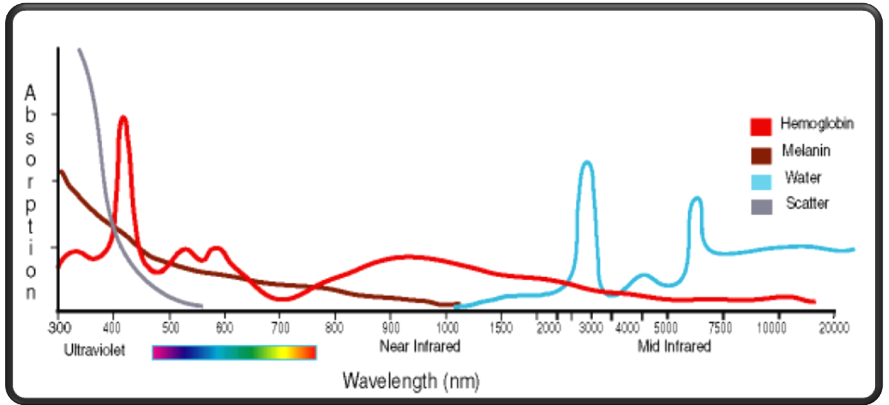
I. Lucid Nd:YAG
2. Absorption Spectrum of Melanin and Hemoglobin

Slide 6
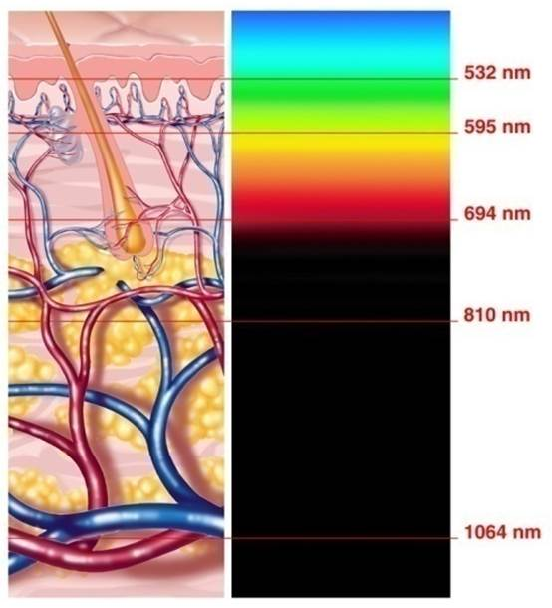
I. Lucid Nd:YAG
3. Depth of Penetration by Wavelength

Slide 7
I. Lucid Nd:YAG
4. User Interface
Notes:
1. Reset
2. Aiming Beam Brightness
3. SAVE
4. Setting
5. Fluence
Fluence is the energy amount from the laser beam per unit area and the unit is J/㎠. If the unit area is smaller with the same energy amount, Fluence goes up and that can cause burning. When you make Spot Size smaller, adjust the value of Fluence.
6. Shot
7. Stand by
8. Handpiece and spot size
9. Indication
10. Wavelength
11. Frequency

Slide 8
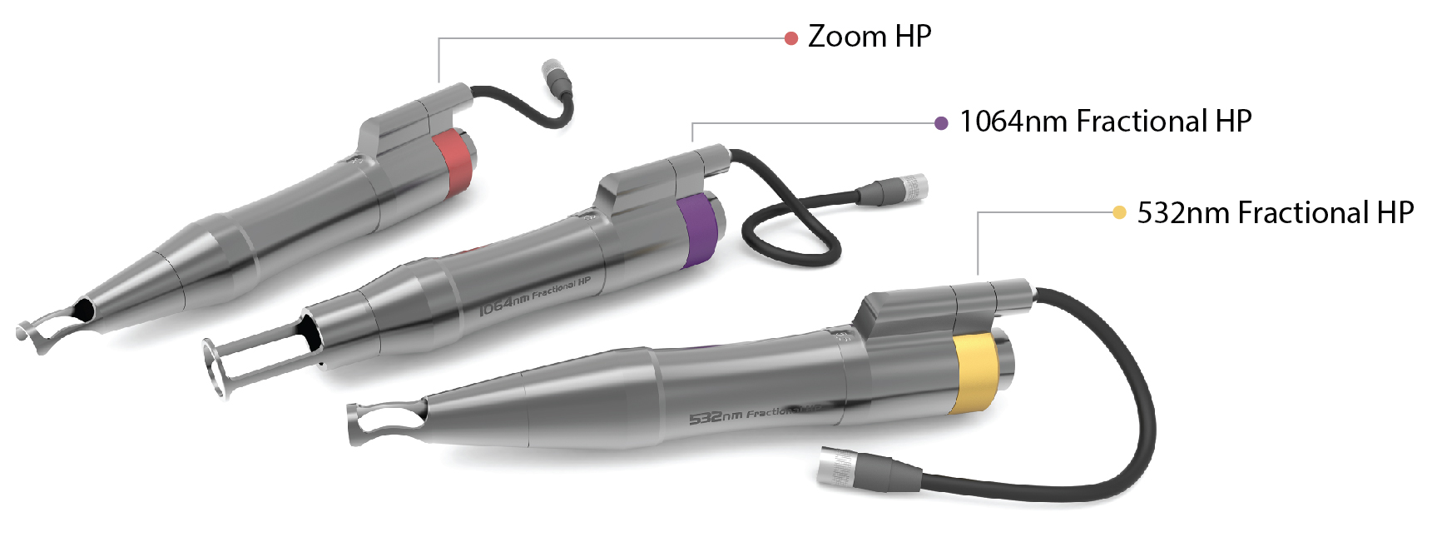
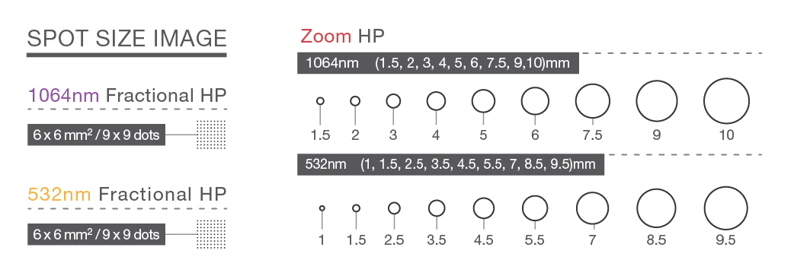
I. Lucid Nd:YAG
5. Fractional HP
Notes:
Fractional handpiece makes the laser beam finely divided micro units to leave the normal tissue between the beams, thereby shortening the downtime and speeding up regeneration, compared to zoom handpiece. Fractional HP has the advantage of procedural repeatability at short intervals. Both patients and doctors hope that the downtime is eliminated or minimized by the short recovery time for epidermis, along with little side effect, greater safety and efficacy of treatment.
81 small spots which have same energy density within the beam of ‘6mm by 6mm’ square spot size are distributed in fractions. The depth of penetration can be increased by duplicate irradiation.

Slide 9
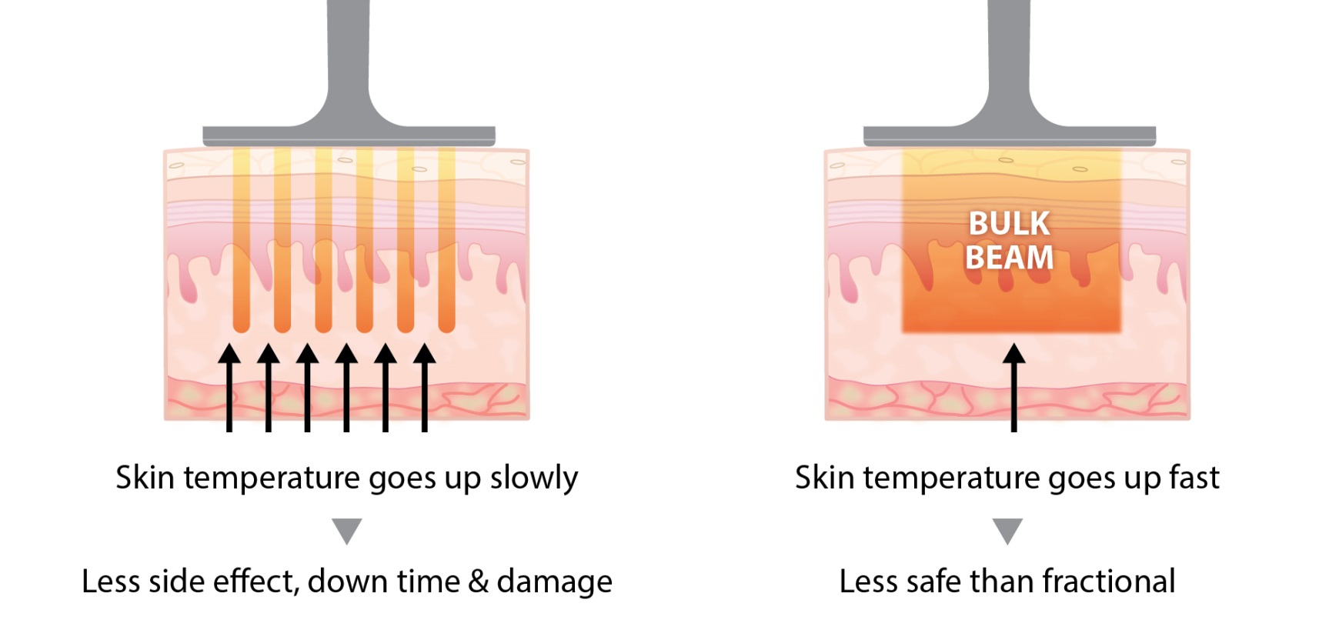
I. Lucid Nd:YAG
5. 1064 Fractional HP

Slide 10
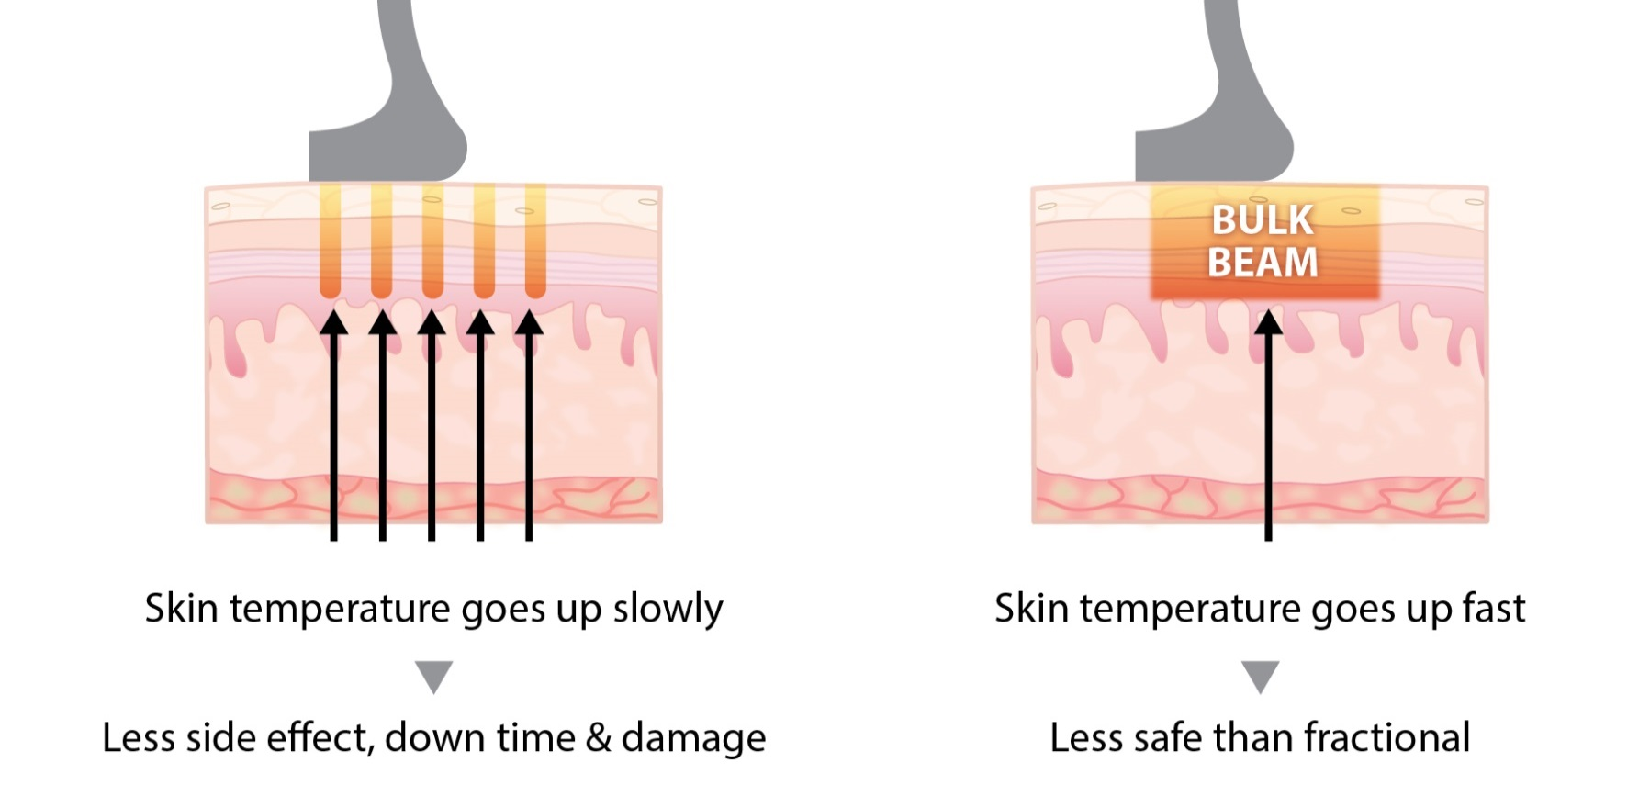
I. Lucid Nd:YAG
5. 532 Fractional HP

Slide 11
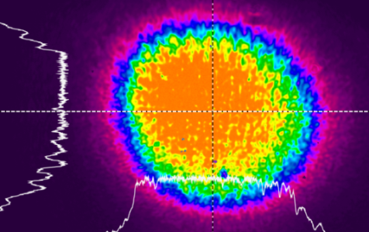
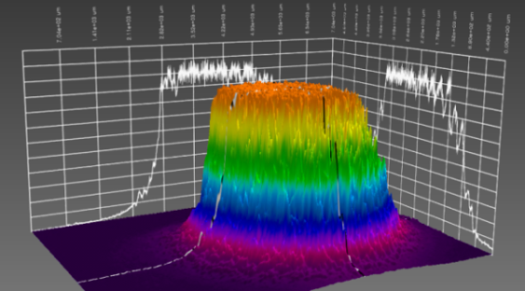
I. Lucid Nd:YAG
5. Zoom HP and Fractional HP
· Zoom Handpiece 10 mm
· Fractional Handpiece 6 x 6 mm / 81 dots
· Tophat Mode 2D Beam Profiler
· Tophat Mode 3D Beam Profiler

Slide 12
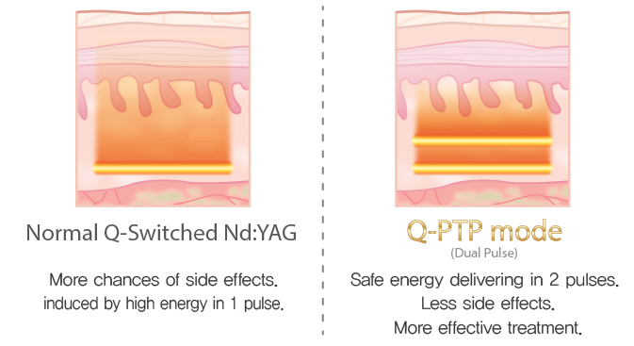
I. Lucid Nd:YAG
6. Photoacustic Twin Pulse
To reduce hypopigmentation and hyperpigmentation caused by high energy laser for Dermal melanocytic lesions and Epidermal melanocytic lesions.
PTP(Photoacustic Twin Pulse)mode is able to provide less pain

Slide 13
II. Benefits of Q switched Nd:YAG laser
Recent years have witnessed an increase in the laser soft feel procedure that peels the stratum corneum by using the Q switched Nd:YAG laser on the face covered with topical carbon cream. Q switched Nd:YAG laser is widely used as necessary element amidst the heightened interest in laser toning that treats pigmented lesions and Melasma using the wide spot size with relatively low energy. Currently, there are three types of laser based on Q switched method. Although the ruby alexandrite laser Nd:YAG is available, the Nd:YAG is considered to be the cheapest and incurs less maintenance cost.

Slide 14
III. Various procedures
1. Dermal melanocytic lesions
Nevus of Ota
Tattoo
2. Epidermal melanocytic lesions
Freckle
3. Combination of Quasi-Long mode and Q switched mode
LARGE PORE+PIGMENTATION+CARBON PEEL
CARBON PEEL + ACNE ROSACEA
4 Q-Switched Nd:YAG Laser toning
Background and definition
Method of procedure
End Points

Slide 15
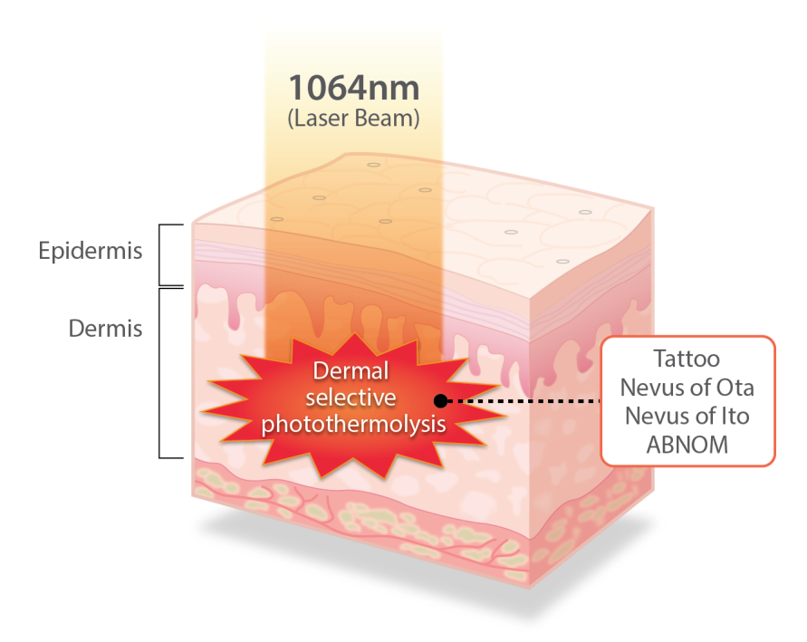
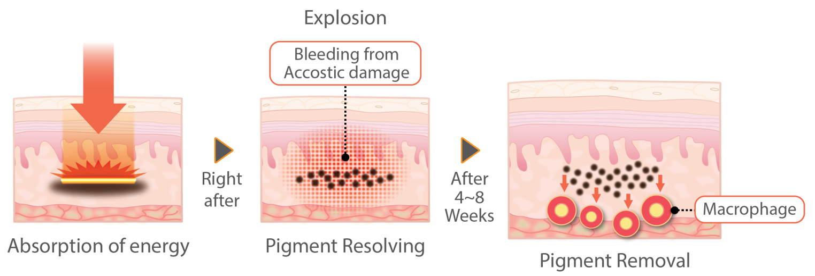
III. Various procedures
1. Dermal melanocytic lesions

Slide 16
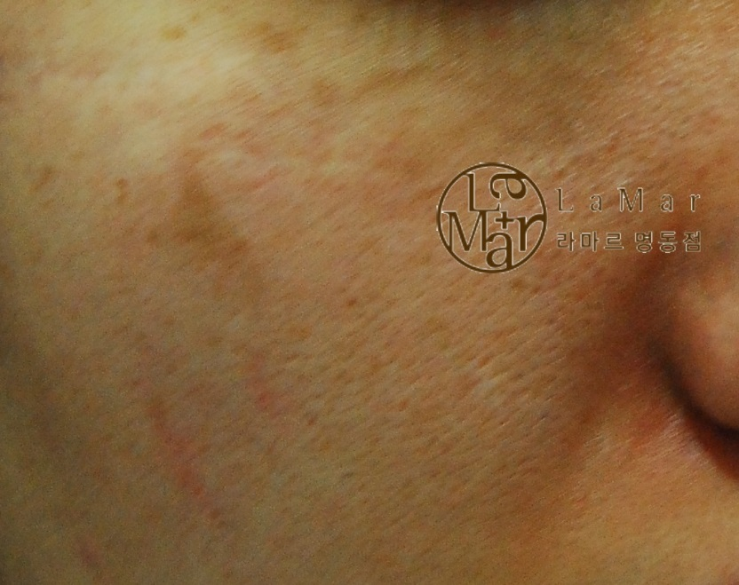
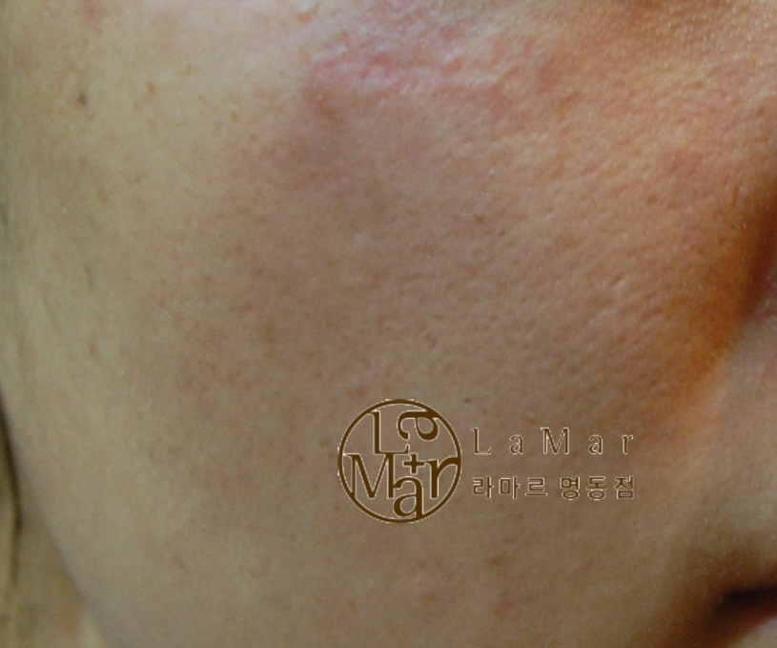
III. Various procedures
1. Dermal melanocytic lesions
1) Nevus of Ota
Before
After
Reference by Dr. Kim Sanghyeok D.M.D., M.D

Slide 17
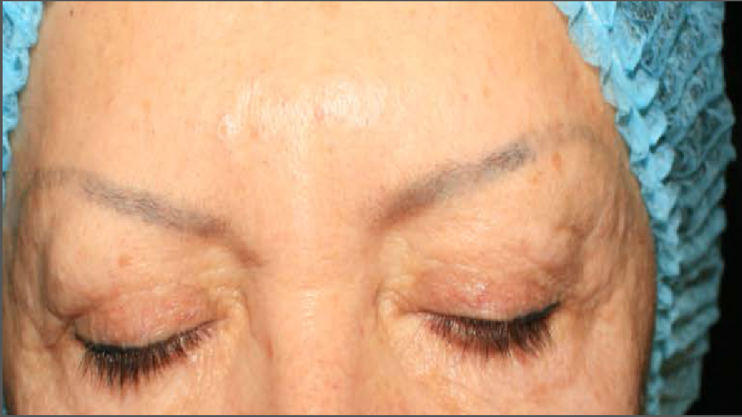
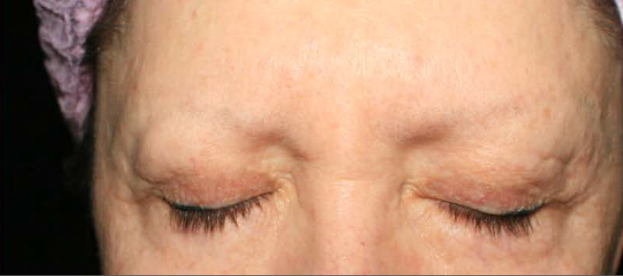
III. Various procedures
1. Dermal melanocytic lesions
2) Tattoo
Before
After
Reference by Dr. Vladislav Chistov D.M.D., M.D

Slide 18
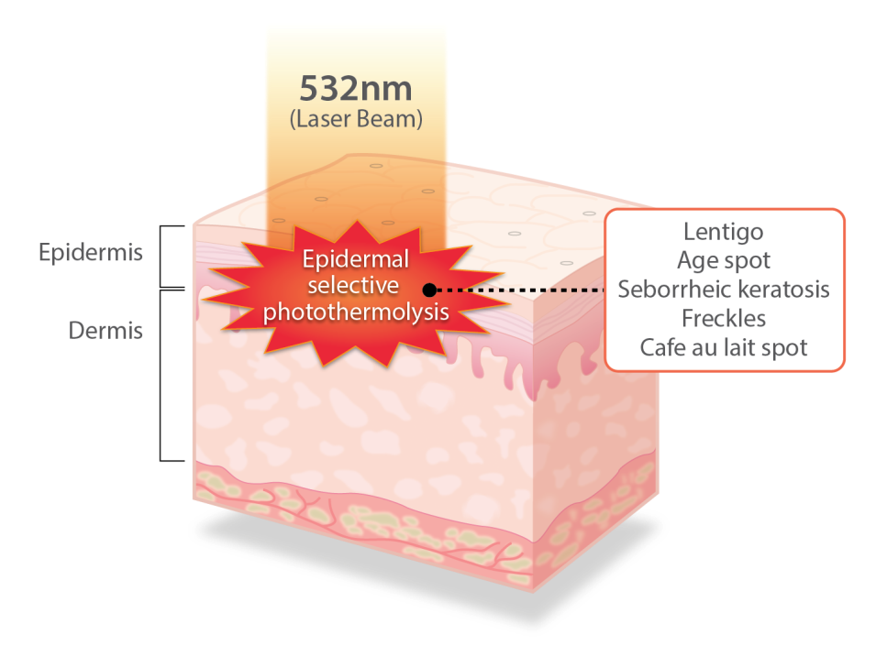
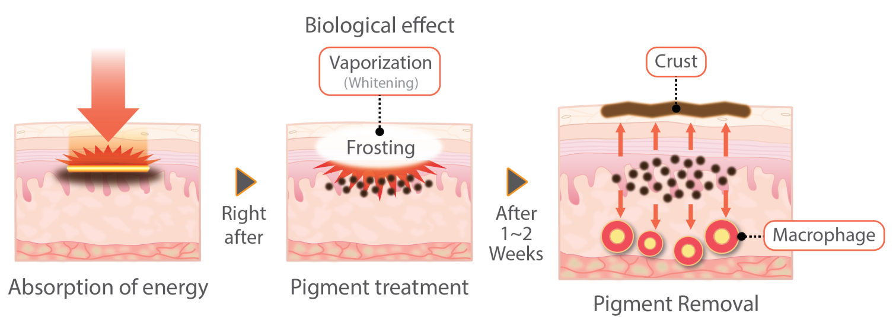
III. Various procedures
2. Epidermal melanocytic lesions

Slide 19
III. Various procedures
Freckle
Wavelength : 532
Spot Size : 3.5 ~ 4.5 Zoom HP
Fluence : 1.5 J/cm2
Hz : 1
2. Epidermal melanocytic lesions

Slide 20
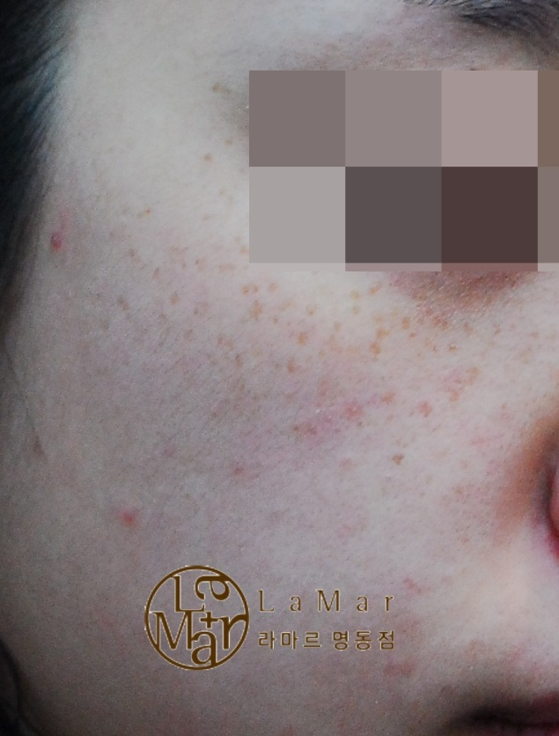
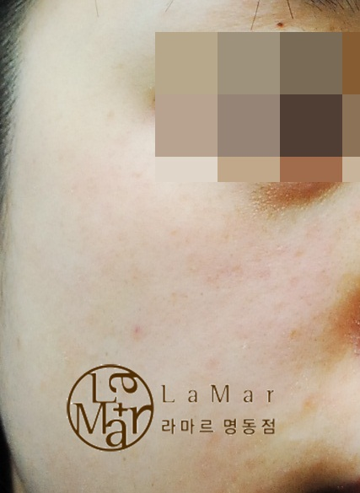
III. Various procedures
2. Epidermal melanocytic lesions
1) Freckle 1
Before
After
Reference by Dr. Kim Sanghyeok D.M.D., M.D

Slide 21
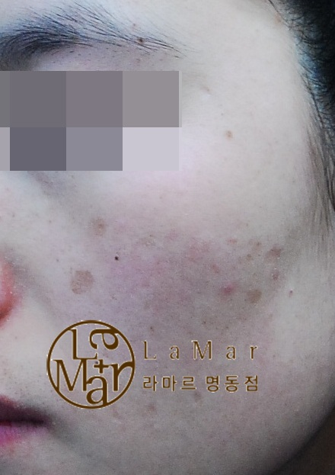
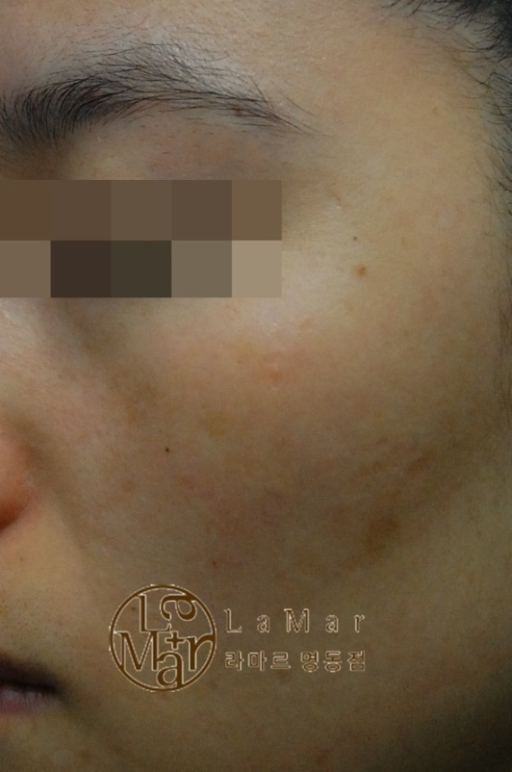
III. Various procedures
2. Epidermal melanocytic lesions
1) Freckle 2
Before
After
Reference by Dr. Kim Sanghyeok D.M.D., M.D

Slide 22
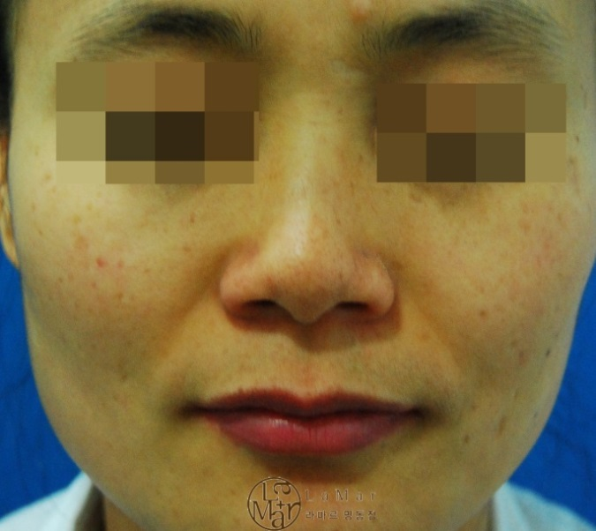
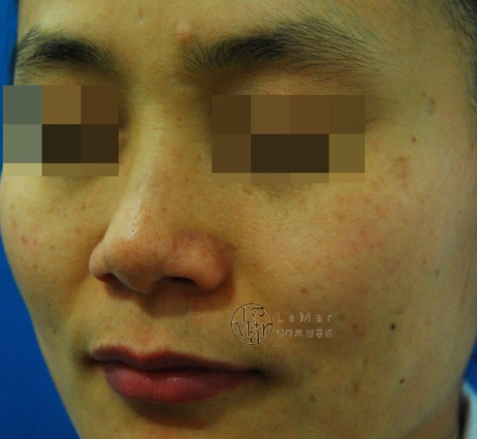
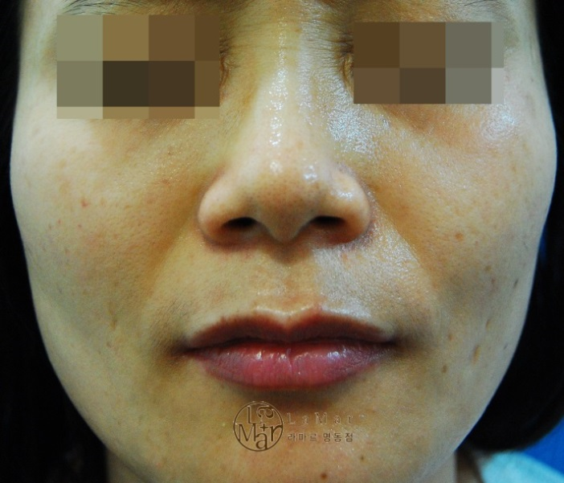
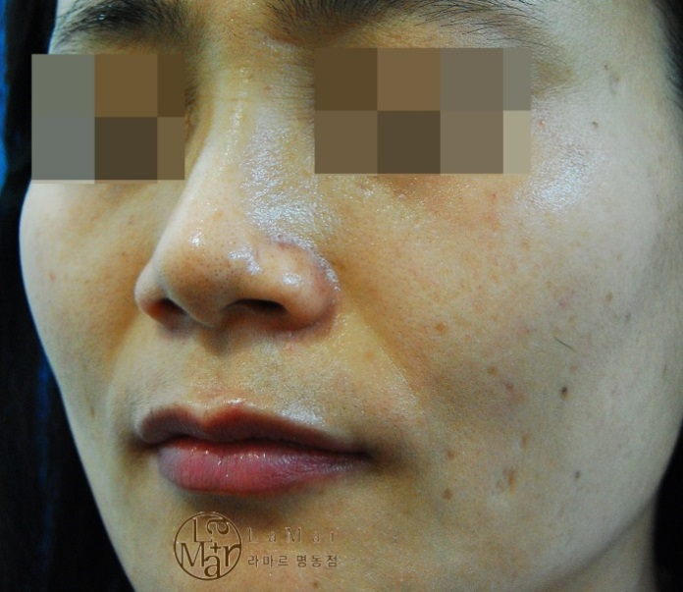
III. Various procedures
2. Epidermal melanocytic lesions
1) Freckle 3
Before
After
Reference by Dr. Kim Sanghyeok D.M.D., M.D

Slide 23
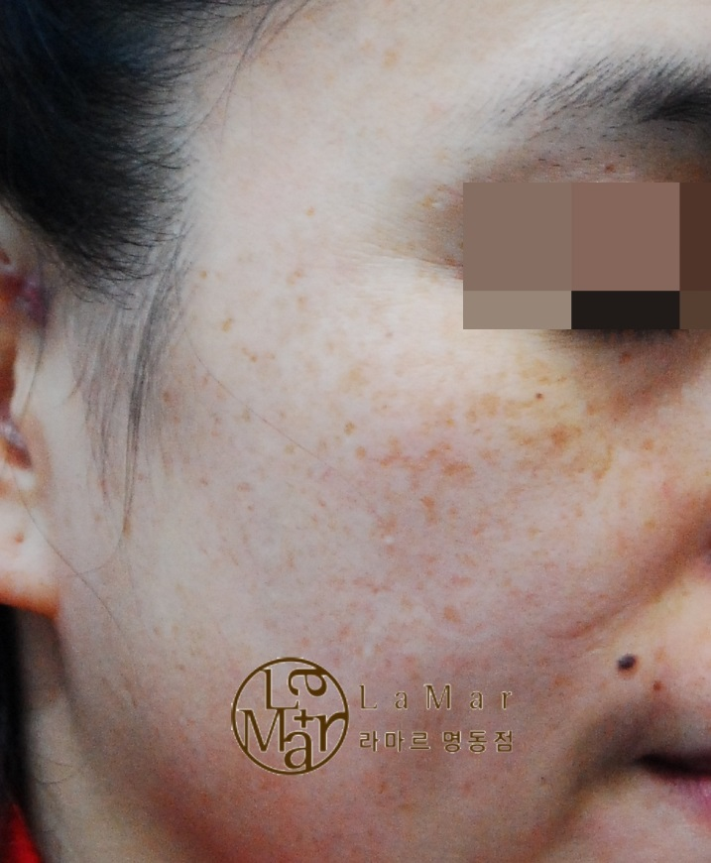
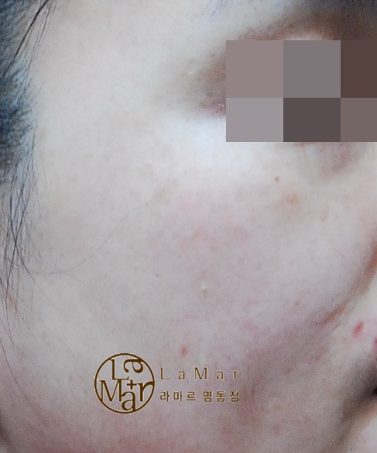
III. Various procedures
2. Epidermal melanocytic lesions
1) Freckle 4
Before
After
Reference by Dr. Kim Sanghyeok D.M.D., M.D

Slide 24
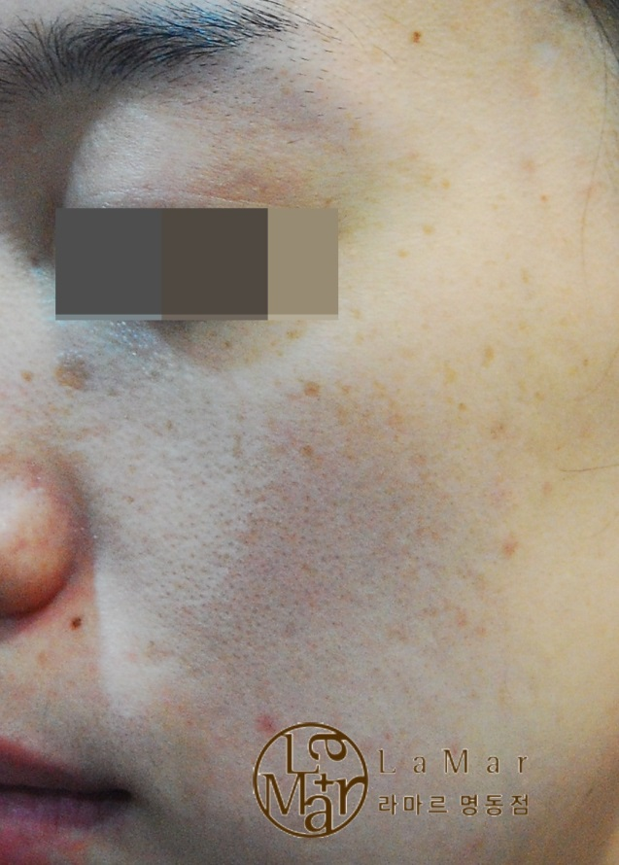
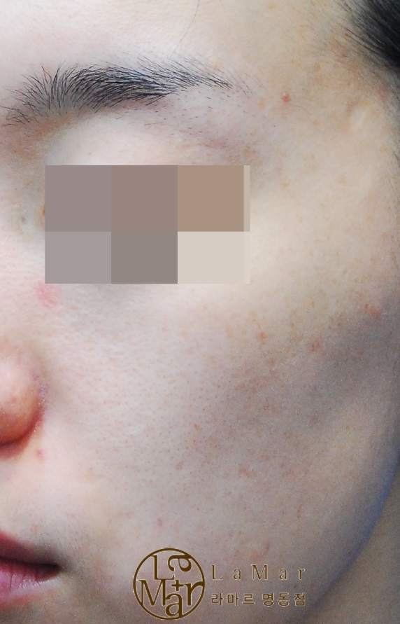
III. Various procedures
2. Epidermal melanocytic lesions
1) Freckle 5
Before
After
Reference by Dr. Kim Sanghyeok D.M.D., M.D

Slide 25
III. Various procedures
3. Combination of Quasi-Long mode + Q switched mode
The procedure begins with the application of carbon cream to the surface of skin, followed by the penetration of 1064nm Quasi-Long laser into the skin. As the pulse duration is 5ns which is much shorter than the thermal relaxation time of the target, the instantaneous energy is used up at the first reaction, and consequently, has little time to spread
By contrast, Quasi-Long Mode allows the laser to be irradiated with the pulse duration of 300us exceeding the thermal relaxation time. Therefore, there is adequate time to diffuse the heat into the surrounding area of tissue, and the thermal effect, created in this way, makes the skin temperature rise slowly. This thermal effect naturally stimulates the re-synthesis of collagen, improving skin elasticity and skin tone at the same time.
Notes:
The procedure begins with the application of carbon cream to the surface of skin, followed by the penetration of 1064nm Quasi-Long laser into the skin. The tissue containing the carbon particles causes explosion, if irradiated by laser beam that has very high peak energy and very short pulse duration. As the pulse duration is 5ns which is much shorter than the thermal relaxation time of the target, the instantaneous energy is used up at the first reaction, and consequently, has little time to spread
By contrast, Quasi-Long Mode allows the laser to be irradiated with the pulse duration of 300us exceeding the thermal relaxation time. Therefore, there is adequate time to diffuse the heat into the surrounding area of tissue, and the thermal effect, created in this way, makes the skin temperature rise slowly. This thermal effect naturally stimulates the re-synthesis of collagen, improving skin elasticity and skin tone at the same time.

Slide 26
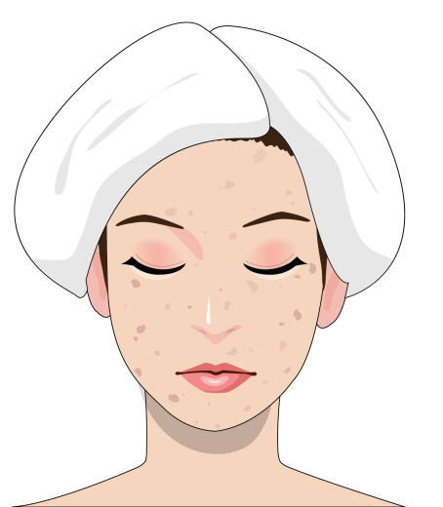
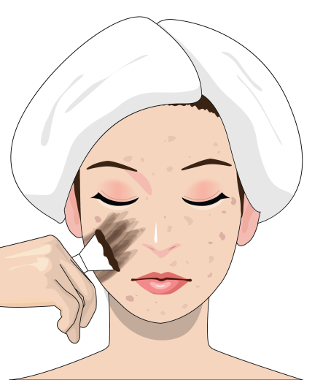
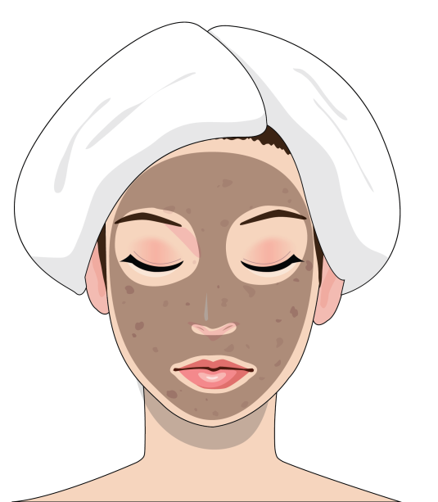
III. Various procedures
Preparation of the face and laser treatment technique
1
2
Patient’s face should be washed
The Carbon gel(cream) is applied evenly over the face.
3
Wait 10 to 20 minutes for Carbon gel(cream) absorbed into the skin.

Slide 27
III. Various procedures
1) First treatment with Carbon Cream

Slide 28
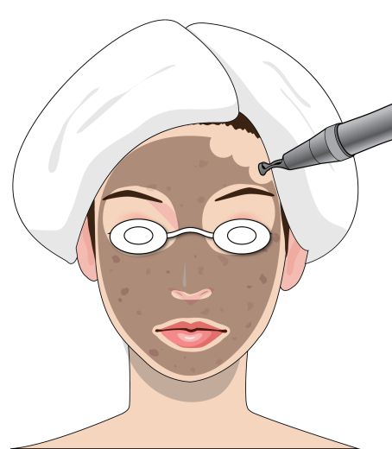
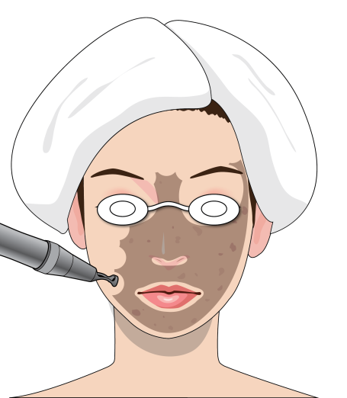
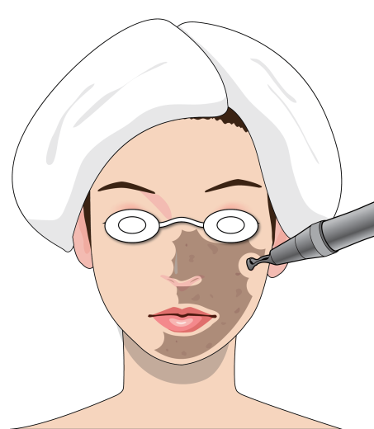
III. Various procedures
i) Quasi-Long Pulse Mode
1
2
Quasi-Long
1064 Zoom HP
Spot Size 7.5mm
1.8 ~ 2.3J/cm2
Quasi-Long
1064 Zoom HP
Spot Size 7.5mm
1.8 ~ 2.3J/cm2
All of the areas to be treated were covered in 3 passes (horizontal, vertical, and diagonal) with 25 to 30% overlapping until the popping sound was no longer heard.
3
Quasi-Long
1064 Zoom HP
Spot Size 7.5mm
1.8 ~ 2.3J/cm2

Slide 29
III. Various procedures
2) Second treatment Q-Switched Mode

Slide 30
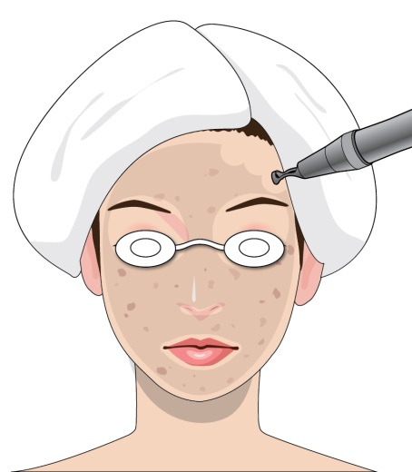
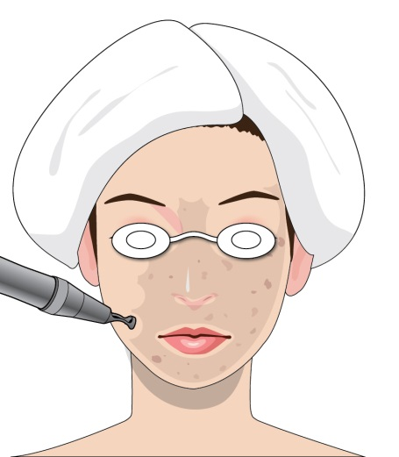
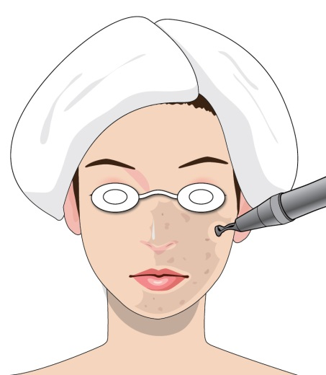
III. Various procedures
i) Laser treatment technique
1064 PTP Q-Switched Mode
Fractional HP
1.8 ~ 2.0 J/cm2

Slide 31
III. Various procedures
3) Third treatment Q-Switched Mode

Slide 32
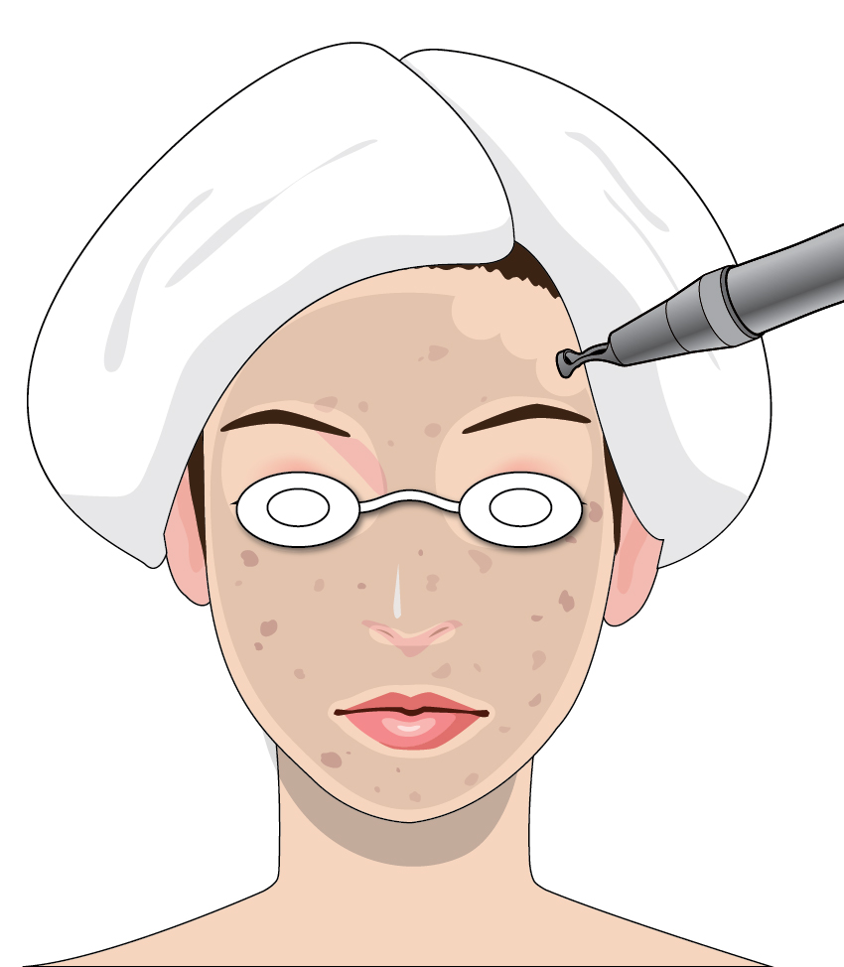
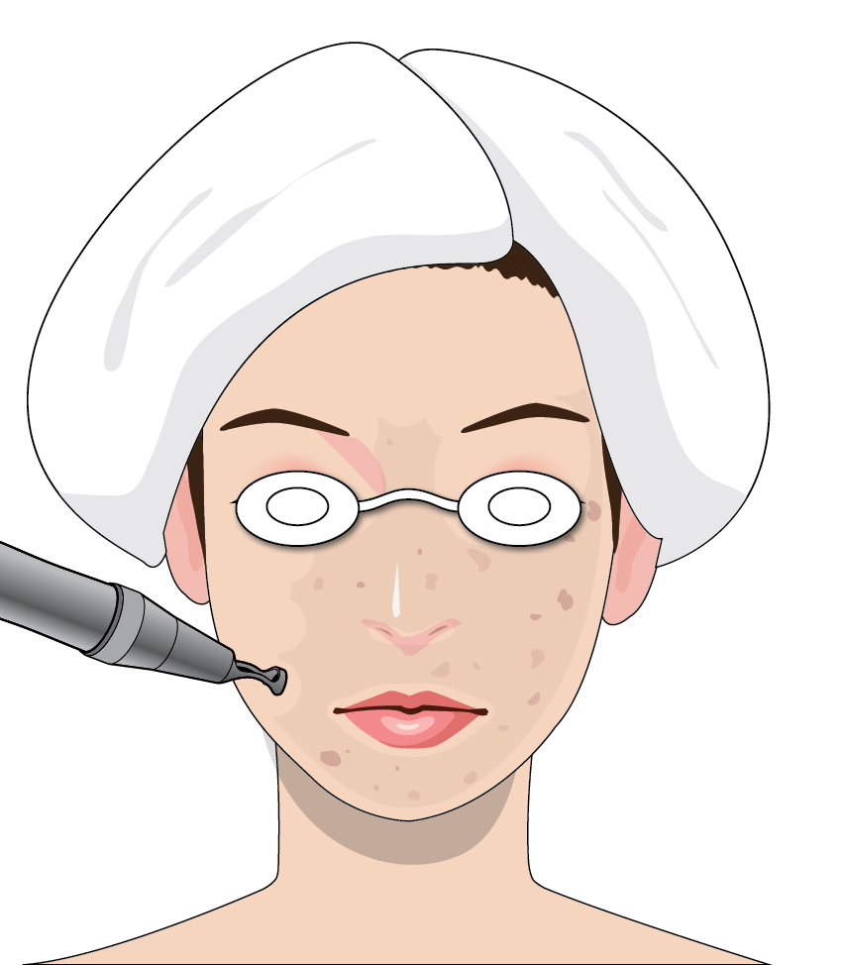
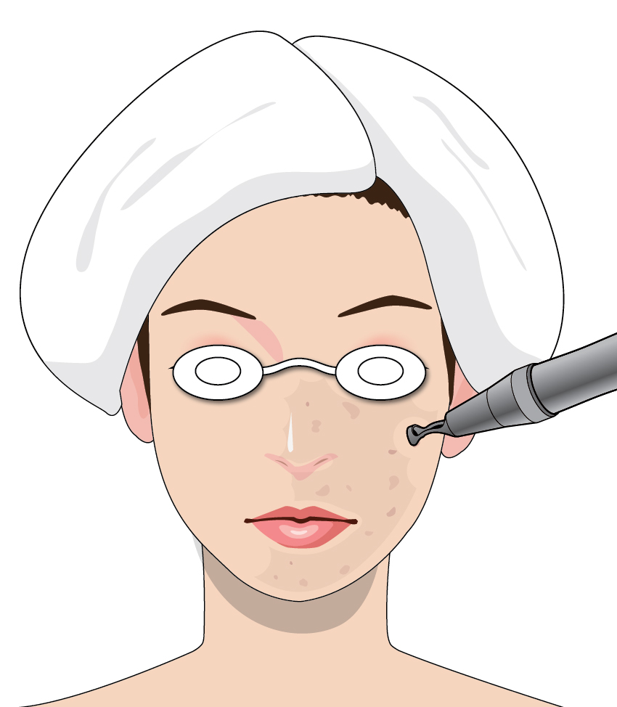
III. Various procedures
i) Laser treatment technique
1064 Q-Switched Mode
Fractional HP
1.5 ~ 1.8 J/cm2

Slide 33
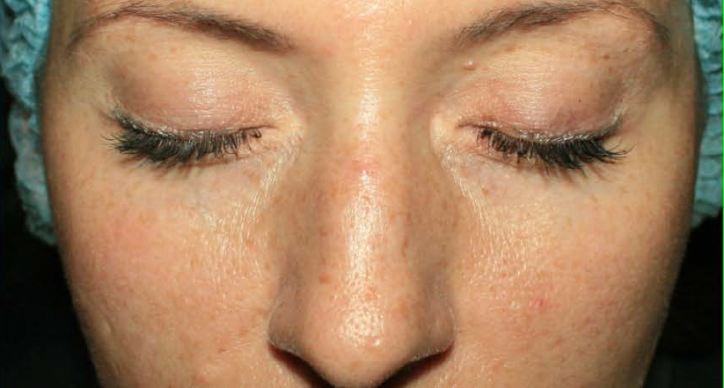
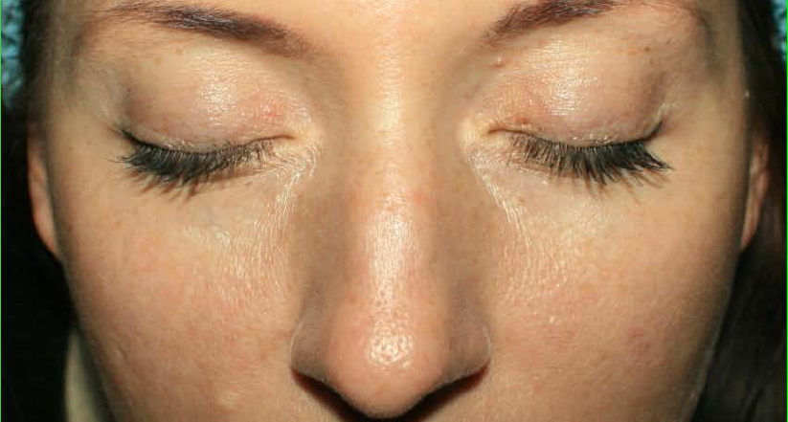
III. Various procedures
3. Combination of Quasi-Long mode + Q switched mode
1) LARGE PORE+PIGMENTATION+CARBON PEEL
Before
After
Reference by Dr. Vladislav Chistov D.M.D., M.D

Slide 34
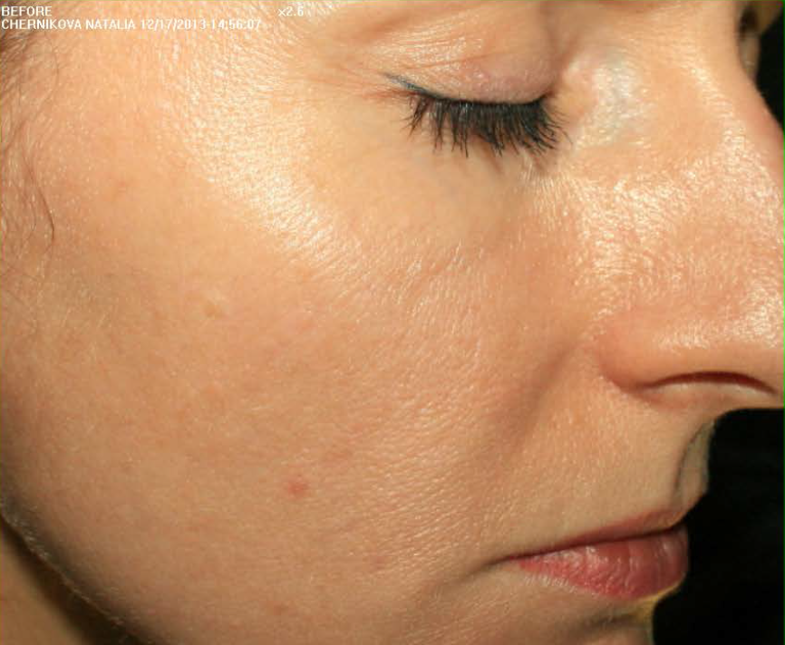
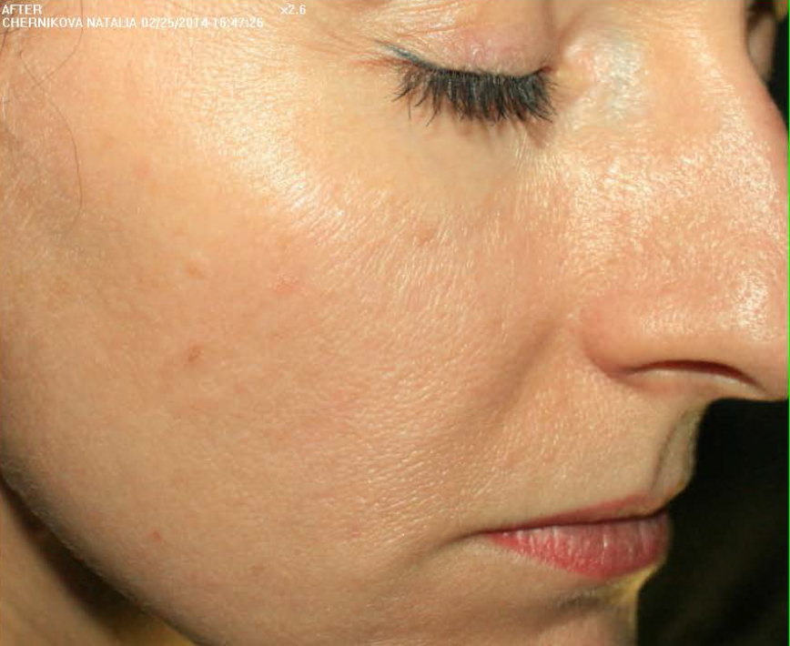
III. Various procedures
3. Combination of Quasi-Long mode + Q switched mode
1) LARGE PORE+PIGMENTATION+CARBON PEEL
Before
After
Reference by Dr. Vladislav Chistov D.M.D., M.D

Slide 35
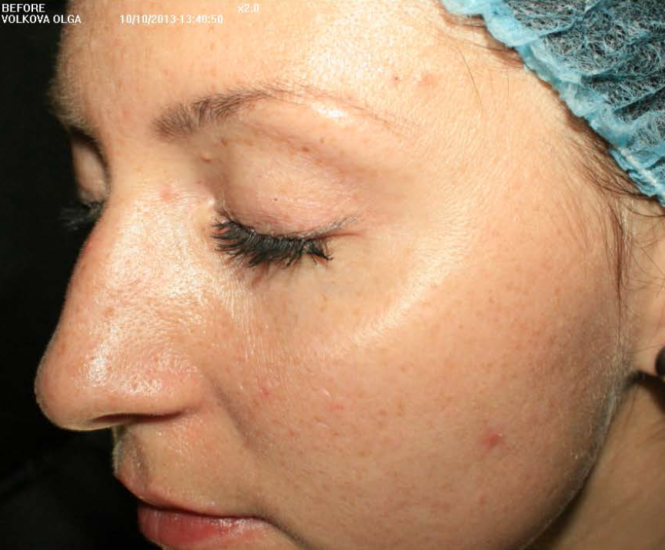
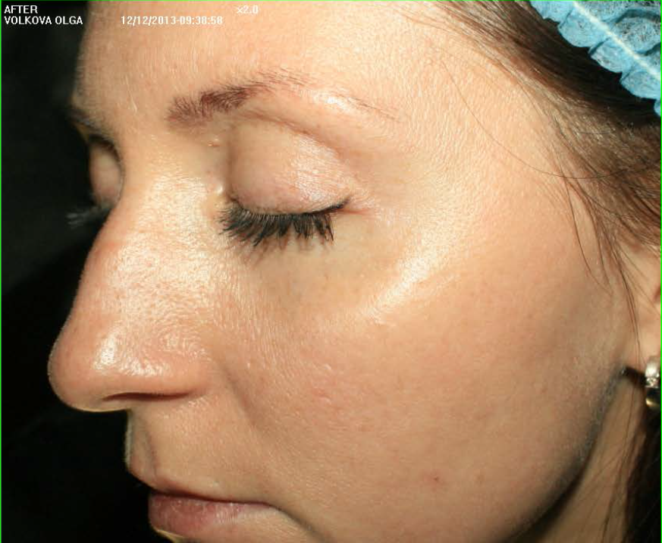
III. Various procedures
3. Combination of Quasi-Long mode + Q switched mode
1) LARGE PORE+PIGMENTATION+CARBON PEEL
Before
After
Reference by Dr. Vladislav Chistov D.M.D., M.D

Slide 36
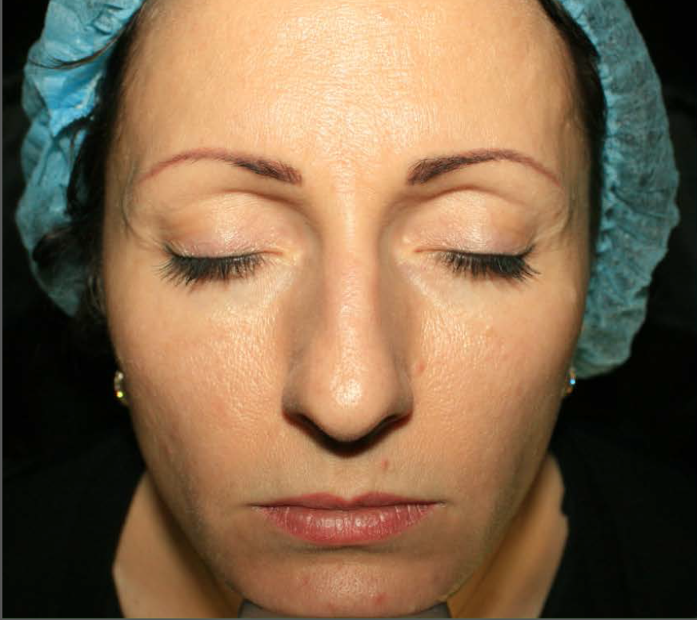
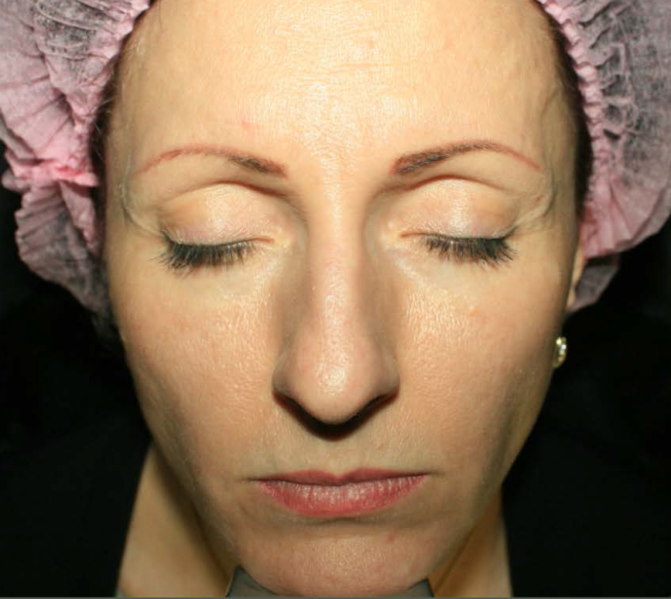
III. Various procedures
3. Combination of Quasi-Long mode + Q switched mode
1) LARGE PORE+PIGMENTATION+CARBON PEEL
Before
After
Reference by Dr. Vladislav Chistov D.M.D., M.D

Slide 37
III. Various procedures
3. Combination of Quasi-Long mode + Q switched mode
1) LARGE PORE+PIGMENTATION+CARBON PEEL
Before
After
Reference by Dr. Vladislav Chistov D.M.D., M.D

Slide 38
III. Various procedures
3. Combination of Quasi-Long mode + Q switched mode
1) LARGE PORE+PIGMENTATION+CARBON PEEL
Before
After
Reference by Dr. Vladislav Chistov D.M.D., M.D

Slide 39
III. Various procedures
3. Combination of Quasi-Long mode + Q switched mode
2) CARBON PEEL + ACNE ROSACEA
Before
After
Reference by Dr. Vladislav Chistov D.M.D., M.D

Slide 40
III. Various procedures
3. Combination of Quasi-Long mode + Q switched mode
2) CARBON PEEL + ACNE ROSACEA
Before
After
Reference by Dr. Vladislav Chistov D.M.D., M.D

Slide 41
III. Various procedures
3. Combination of Quasi-Long mode + Q switched mode
2) CARBON PEEL + ACNE ROSACEA
Before
After
Reference by Dr. Vladislav Chistov D.M.D., M.D

Slide 42
III. Various procedures
4. Q-Switched Nd:YAG Laser toning
1) Background and definition
2) Method of procedure
3) End Points

Slide 43
III. Various procedures
4. Q-Switched Nd:YAG Laser toning
1) Background and definition
The term, “Laser toning”, seems to have been coined in the United States in 1999 and has been used for describing the non-ablative laser treatment rejuvenating the skin. However, in Korea, the term “laser toning” means the treatment of melasma with 1064nm Q-Switched Nd:YAG based on very short pulse duration and relatively law energy density. This is the laser concept built on the notion of subcellular selective photothermolysis(SSP) that selectively destroys only the melanin without any damage to melanocyte.
Notes:
The term, “Laser toning”, seems to have been coined in the United States in 1999 and has been used for describing the non-ablative laser treatment rejuvenating the skin. However, in Korea, the term “laser toning” means the treatment of melasma with 1064nm Q-Switched Nd:YAG based on very short pulse duration and relatively law energy density. This is the laser concept built on the notion of subcellular selective photohermolysis(SSP) that selectively destroys only the melanin without any damage to melanocyte.

Slide 44
III. Various procedures
Melasma toning
Wavelength : 1064
Spot Size : 9 Zoom HP
Fluence : 1.5 ~ 1.8 J/cm2
Hz : 10
4. Q-Switched Nd:YAG Laser toning
2) Method of procedure

Slide 45
III. Various procedures
4. Q-Switched Nd:YAG Laser toning
3) Melasma 1
Before
After
Reference by Dr. Kim Sanghyeok D.M.D., M.D

Slide 46
III. Various procedures
4. Q-Switched Nd:YAG Laser toning
3) Melasma 2
Before
After
Reference by Dr. Kim Sanghyeok D.M.D., M.D

Slide 47
III. Various procedures
4. Q-Switched Nd:YAG Laser toning
3) Melasma 3
Before
After
Reference by Dr. Kim Sanghyeok D.M.D., M.D

Slide 48
III. Various procedures
4. Q-Switched Nd:YAG Laser toning
3) Melasma 4
Before
After
Reference by Dr. Kim Sanghyeok D.M.D., M.D

Slide 49
III. Various procedures
4. Q-Switched Nd:YAG Laser toning
3) End Points
Epidermal
melasma
The pigments immediately become thinner with the fluffs immediately turning white and the erythema appears around the lesion.
Dermal or
mixed type of
melasma
The lesion immediately becomes dark, and erythema appears around the lesion.
PIH
The lesion is immediately blurred, and erythema appears around the lesion.

Slide 50
IV. Conclusion
PTP has the advantage that it can increase the energy up to the threshold of pigment reaction. As the irradiation time is short, the damage to pigments is more severe while the cooling time is relatively prolonged for normal tissues. Therefore, greater treatment effect and fewer side effects can be expected.
Nd:YAG has the lowest maintenance cost among the Q switched lasers..
User-friendly UI & equipment design, constant upgrade and safety are also the advantage that sets it apart from others.
It is due to this technique of Q switching that the principle of selective photothermolysis can be applied to the pigmented lesions to achieve the desired clinical results without much damage to the surrounding area.

Slide 51
Thank You !
Any Question please e-mail us at bison@bisonmedical.com
· Reference by Dr. Kim Sanghyeok D.M.D., M.D
www.my-lamar.com
· Reference by Dr. Vladislav Chistov D.M.D., M.D
www.oblik-clinic.ru
· Written and Edited by Bison Medical
www.bisonmedical.com

